Slide 1
🛡
PII Detector & Masker
Hybrid AI Privacy Detection & Masking Engine
Detect • Mask • Report • Protect
Email
Phone
PAN
Aadhaar
Presented by Team PII Shield | 2026

Slide 2
INTRODUCTION
Why Protecting PII Matters
Personally Identifiable Information (PII) — such as Email IDs, Phone Numbers, PAN, and Aadhaar — is often hidden inside everyday datasets. Sharing such data without protection leads to privacy breaches, security incidents, and regulatory penalties.
We built an AI-assisted solution that automatically detects and masks sensitive information before data is shared.
80%
of data leaks involve PII
4
PII types detected
AI+Regex
Hybrid detection layer
PII Shield AI • Hybrid AI Privacy Detection Engine
1 / 14

Slide 3
PROBLEM STATEMENT
The Risk Inside Every Dataset
Sensitive Data Everywhere
⚠ IF SHARED PUBLICLY
1
Datasets routinely contain emails, phone numbers, and government IDs.
Plain text example:
Rahul, rahul@gmail.com, 9876543210
Manual Review Fails
2
● Privacy Violation
Identifying PII by hand is slow, inconsistent, and unscalable.
● Identity Theft
● Regulatory Penalty (GDPR, DPDP)
Human Errors Cause Leaks
3
A single missed field can trigger a privacy breach or compliance violation.
PII Shield AI • Hybrid AI Privacy Detection Engine
2 / 14

Slide 4
PROJECT OBJECTIVE
What Our System Delivers
🔍
Detects PII
🛡
Masks Sensitive Data
📄
Generates Reports
Identifies Emails, Phones, PAN, Aadhaar with hybrid AI+Regex.
Replaces values with safe, partially-redacted equivalents.
Produces detailed JSON & CSV reports of every detection.
📊
Displays Analytics
⬇
Download Masked File
⚙
Automated Tests
Live dashboard with counts, charts, and compliance score.
Export sanitized CSV ready for safe sharing.
Pytest suite validates accuracy and reliability.
PII Shield AI • Hybrid AI Privacy Detection Engine
3 / 14

Slide 5
ARCHITECTURE OVERVIEW
End-to-End Data Flow
User Upload
▶
Flask Application
▶
CSV Processing
▶
Regex + AI Detection
1
2
3
4
▼ ▼ ▼ ▼
Masking Engine
▶
Report Generation
▶
Dashboard
▶
Download Output
5
6
7
8
PII Shield AI • Hybrid AI Privacy Detection Engine
4 / 14

Slide 6
DETECTION LAYER 1
Regex-Based Pattern Matching
Email
[a-zA-Z0-9._%+-]+@[a-zA-Z0-9.-]+\.[a-zA-Z]{2,}
Phone
\d{10}
PAN
[A-Z]{5}[0-9]{4}[A-Z]
Aadhaar
\d{12}
PII Shield AI • Hybrid AI Privacy Detection Engine
5 / 14

Slide 7
DETECTION LAYER 2
AI Validation for Accuracy
Input File
→
Regex Detection
→
AI Validation
→
Masking
🎯 Reduce False Positives
🛡 Improve Reliability
AI validates regex matches against context, filtering out look-alike numbers (order IDs, ZIPs) that pattern-matching alone would flag.
A second intelligent layer increases trust in the masked output and ensures compliance-grade accuracy across diverse datasets.
PII Shield AI • Hybrid AI Privacy Detection Engine
6 / 14

Slide 8
MASKING ENGINE
Before & After Examples
Original Value
Masked Output
rahul@gmail.com
→
r****@gmail.com
9876543210
→
98****10
ABCDE1234F
→
A****F
1234 5678 9012
→
**** **** 9012
PII Shield AI • Hybrid AI Privacy Detection Engine
7 / 14

Slide 9
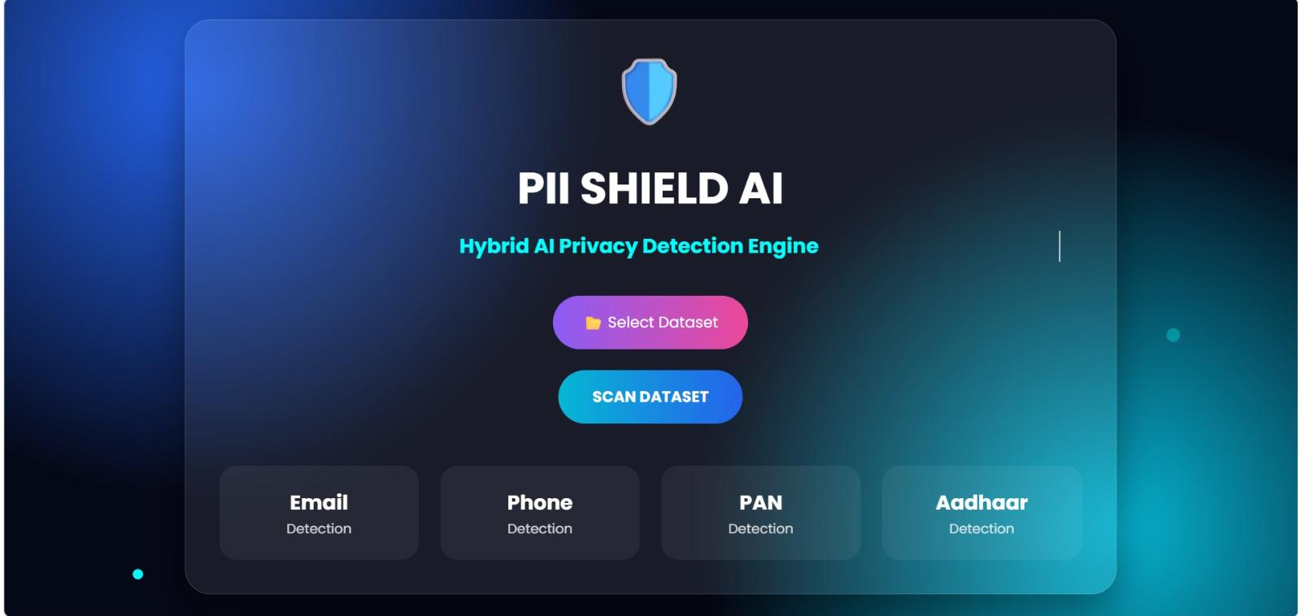
APPLICATION UI
Upload & Scan Interface
User Experience
• Clean, dark-themed dashboard
• One-click dataset selection
• Instant scan trigger
• Visible detection categories
• Modern glassmorphism design
PII Shield AI • Hybrid AI Privacy Detection Engine
8 / 14

Slide 10
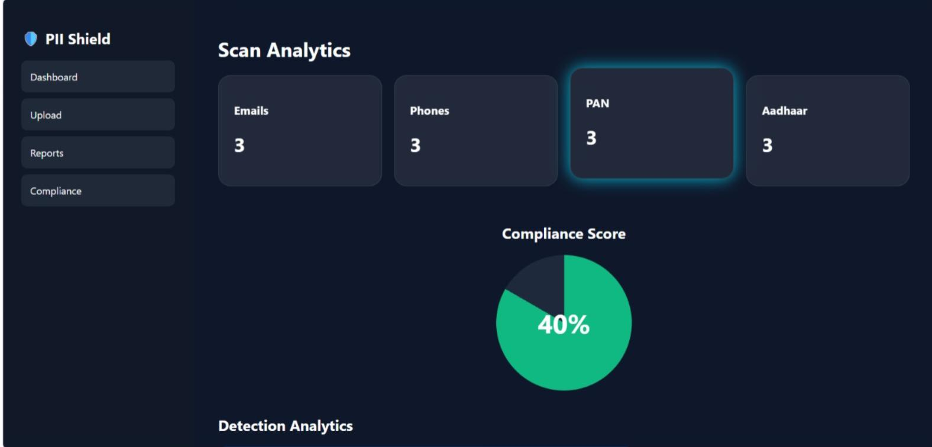
DASHBOARD
Scan Analytics & Compliance
Key Metrics
• Live PII counts per type
• Compliance score (pie)
• Real-time updates
• Sidebar navigation
• Color-coded categories
PII Shield AI • Hybrid AI Privacy Detection Engine
9 / 14

Slide 11
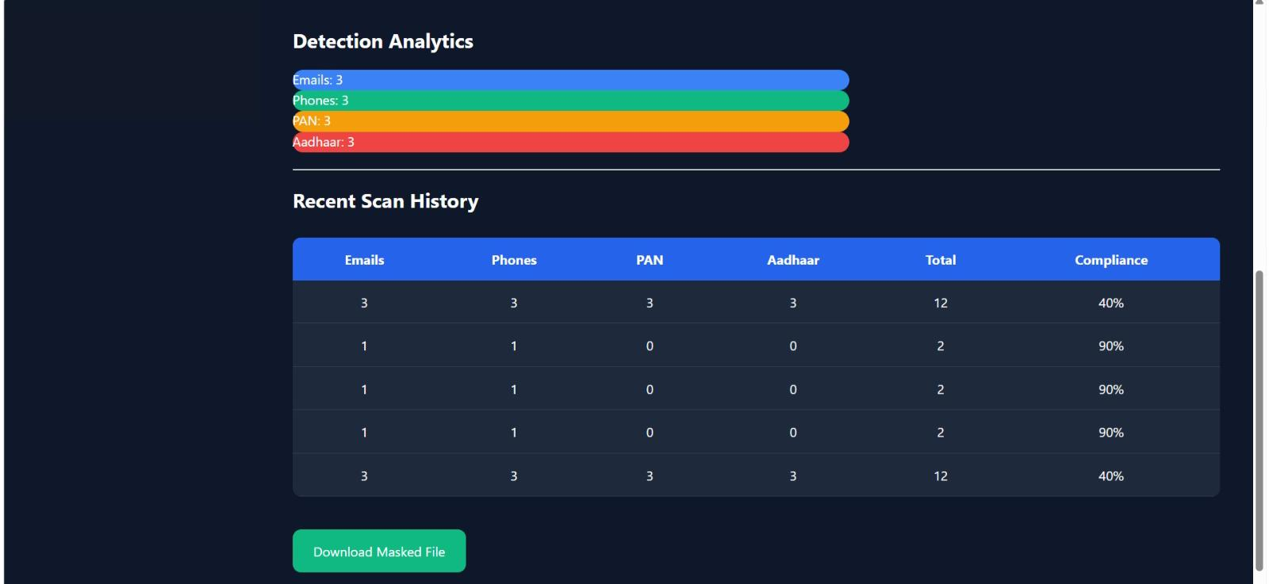
REPORTS
Detection History & Download
Report Features
• Detection bar charts
• Recent scan history table
• Per-scan compliance %
• One-click masked download
• CSV + JSON exports
PII Shield AI • Hybrid AI Privacy Detection Engine
10 / 14

Slide 12
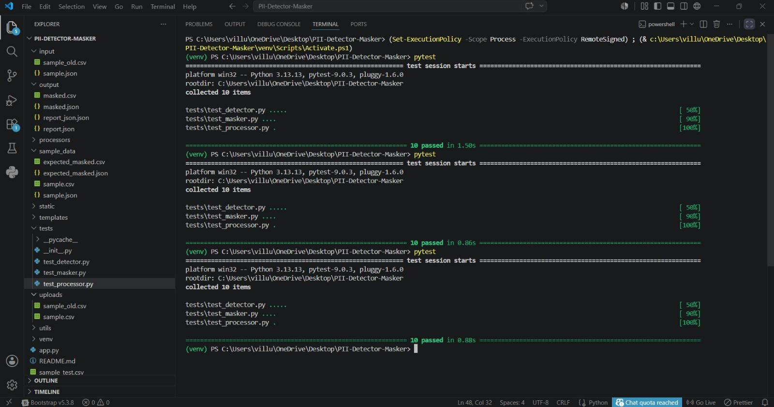
TESTING & VALIDATION
Pytest-Driven Reliability
Input CSV
Masked Output CSV
Name, Email, Phone
Rahul, rahul@gmail.com, 9876543210
Name, Email, Phone
Rahul, r****@gmail.com, 98****10
Validation Coverage
✓ Email detection
✓ Phone masking
✓ PAN identification
✓ Aadhaar accuracy
✓ Masked file generation
✓ Report integrity
PII Shield AI • Hybrid AI Privacy Detection Engine
11 / 14

Slide 13
DELIVERABLES
Documentation & Demo Assets
📚 Documentation Prepared
📦 Project Deliverables
● README.md — setup & usage guide
✅ Source Code (Python + Flask)
● AI Usage Note — model & approach
✅ Documentation Bundle
✅ Pytest Test Cases
● Project Report — detailed write-up
✅ Sample CSV Datasets
● Test Results — pytest outputs
✅ Demo Video Walkthrough
● Architecture Diagrams
✅ Public GitHub Repository
PII Shield AI • Hybrid AI Privacy Detection Engine
12 / 14

Slide 14
🛡
THANK YOU
Questions, Feedback & Demo Welcome
Team PII Detector & Masker
GitHub • Demo Video • Documentation Available

